Slide 1
Computer graphics
Semester 5 – Department of Informatics ITS 2016

Slide 2
Outline
Review Materi Minggu 5
Sesi 1: Representation
Sesi 2: Transformation

Slide 3
Three-dimensional Applications
In OpenGL, two-dimensional applications are a special case of three-dimensional graphics
Going to 3D
Not much changes
Use vec3, glUniform3f
Have to worry about the order in which primitives are rendered or use hidden-surface removal

Slide 4
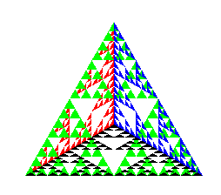
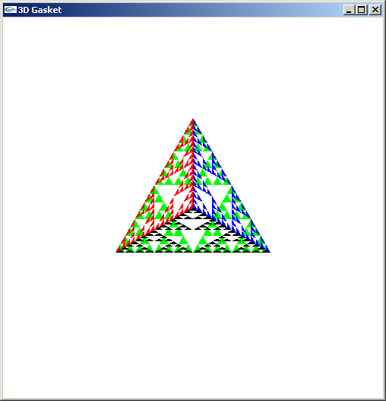
Almost Correct
Because the triangles are drawn in the order they are defined in the program, the front triangles are not always rendered in front of triangles behind them
get this
want this

Slide 5
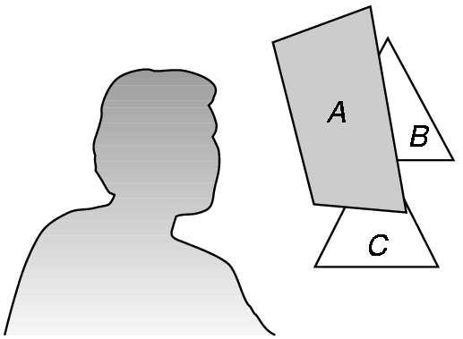
Hidden-Surface Removal
We want to see only those surfaces in front of other surfaces
OpenGL uses a hidden-surface method called the z-buffer algorithm that saves depth information as objects are rendered so that only the front objects appear in the image

Slide 6
Using the z-buffer algorithm
The algorithm uses an extra buffer, the z-buffer, to store depth information as geometry travels down the pipeline
The z-buffer must be
Requested in main.c
glutInitDisplayMode
(GLUT_SINGLE | GLUT_RGB | GLUT_DEPTH)
Enabled in init.c
glEnable(GL_DEPTH_TEST)
Cleared in the display callback
glClear(GL_COLOR_BUFFER_BIT |
GL_DEPTH_BUFFER_BIT)

Slide 7
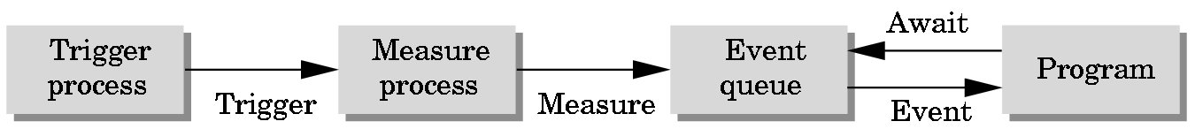
Event Mode
Most systems have more than one input device, each of which can be triggered at an arbitrary time by a user
Each trigger generates an event whose measure is put in an event queue which can be examined by the user program

Slide 8
Callbacks
Programming interface for event-driven input
Define a callback function for each type of event the graphics system recognizes
This user-supplied function is executed when the event occurs
GLUT example: glutMouseFunc(mymouse)
mouse callback function

Slide 9
GLUT callbacks
GLUT recognizes a subset of the events recognized by any particular window system (Windows, X, Macintosh)
glutDisplayFunc
glutMouseFunc
glutReshapeFunc
glutKeyboardFunc
glutIdleFunc
glutMotionFunc, glutPassiveMotionFunc

Slide 10
The mouse callback
glutMouseFunc(mymouse)
void mymouse(GLint button, GLint state, GLint x, GLint y)
Returns
which button (GLUT_LEFT_BUTTON, GLUT_MIDDLE_BUTTON, GLUT_RIGHT_BUTTON) caused event state of that button (GLUT_UP, GLUT_DOWN)
Position in window

Slide 11
Drawing squares at cursor location
void mymouse(int btn, int state, int x, int y)
{
if(btn==GLUT_RIGHT_BUTTON && state==GLUT_DOWN)
exit(0);
if(btn==GLUT_LEFT_BUTTON && state==GLUT_DOWN)
drawSquare(x, y);
}
void drawSquare(int x, int y)
{
y=w-y; /* invert y position */
points[i] = point2(x+size, y+size);
points[i+1] = point2(x-size, y+size);
points[i+2] = point2(x-size, y-size);
points[i+3] = point2 x+size, y-size);
i+=4
}

Slide 12
Using the motion callback
We can draw squares (or anything else) continuously as long as a mouse button is depressed by using the motion callback
glutMotionFunc(drawSquare)
We can draw squares without depressing a button using the passive motion callback
glutPassiveMotionFunc(drawSquare)

Slide 13
Using the keyboard
glutKeyboardFunc(mykey)
void mykey(unsigned char key,
int x, int y)
Returns ASCII code of key depressed and mouse location
void mykey(unsigned char key, int x, int y)
{
if(key == ‘Q’ | key == ‘q’)
exit(0);
}

Slide 14
The Reshape callback
glutReshapeFunc(myreshape)
void myreshape( int w, int h)
Returns width and height of new window (in pixels)
A redisplay is posted automatically at end of execution of the callback
GLUT has a default reshape callback but you probably want to define your own
The reshape callback is good place to put viewing functions because it is invoked when the window is first opened

Slide 15
Defining a simple menu
In main.c
menu_id = glutCreateMenu(mymenu);
glutAddmenuEntry(“clear Screen”, 1);
gluAddMenuEntry(“exit”, 2);
glutAttachMenu(GLUT_RIGHT_BUTTON);
clear screen
exit
entries that appear when
right button depressed
identifiers

Slide 16
Menu actions
Menu callback
Note each menu has an id that is returned when it is created
Add submenus by
glutAddSubMenu(char *submenu_name, submenu id)
void mymenu(int id)
{
if(id == 1) glClear();
if(id == 2) exit(0);
}
entry in parent menu

Slide 17
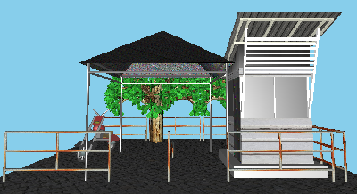
Sesi 1: Representation

Slide 18
Objectives
Introduce concepts such as dimension and basis
Introduce coordinate systems for representing vectors spaces and frames for representing affine spaces
Discuss change of frames and bases
Introduce homogeneous coordinates

Slide 19
Linear Independence
A set of vectors v₁, v₂, …, v_{n} is linearly independent if
α₁v₁ + α₂v₂ + .. + α_{n}v_{n} = 0 iff α₁ = α₂ = … = 0
If a set of vectors is linearly independent, we cannot represent one in terms of the others
If a set of vectors is linearly dependent, at least one can be written in terms of the others

Slide 20
Dimension
In a vector space, the maximum number of linearly independent vectors is fixed and is called the dimension of the space
In an n-dimensional space, any set of n linearly independent vectors form a basis for the space
Given a basis v₁, v₂,…., v_{n}, any vector v can be written as
v = α₁v₁ + α₂v₂ +….+ α_{n}v_{n}
where the {α_{i}} are unique

Slide 21
Representation
Until now we have been able to work with geometric entities without using any frame of reference, such as a coordinate system
Need a frame of reference to relate points and objects to our physical world.
For example, where is a point? Can’t answer without a reference system
World coordinates
Camera coordinates

Slide 22
Coordinate Systems
Consider a basis v₁, v₂,…., v_{n}
A vector is written v = α₁v₁ + α₂v₂ +….+ α_{n}v_{n}
The list of scalars {α₁, α₂, …. α_{n}} is the representation of v with respect to the given basis
We can write the representation as a row or column array of scalars
a = [α₁ α₂ …. α_{n}]^{T}=

Slide 23
Example
v = 2v₁ + 3v₂ - 4v₃
a = [2 3 –4]^{T}
Note that this representation is with respect to a particular basis
For example, in OpenGL we start by representing vectors using the object basis but later the system needs a representation in terms of the camera or eye basis

Slide 24
Coordinate Systems
Which is correct?
Both are because vectors have no fixed location
v
v

Slide 25
Frames
A coordinate system is insufficient to represent points
If we work in an affine space we can add a single point, the origin, to the basis vectors to form a frame
v₂
v₁
P₀
v₃

Slide 26
Representation in a Frame
Frame determined by (P₀, v₁, v₂, v₃)
Within this frame, every vector can be written as
v = α₁v₁ + α₂v₂ +….+ α_{n}v_{n}
Every point can be written as
P = P₀ + β₁v₁+ β₂v₂ +….+β_{n}v_{n}

Slide 27
Confusing Points and Vectors
Consider the point and the vector
P = P₀ + β₁v₁+ β₂v₂ +….+β_{n}v_{n}
v = α₁v₁+ α₂v₂ +….+α_{n}v_{n}
They appear to have the similar representations
p=[β₁ β₂ β₃] v=[α₁ α₂ α₃]
which confuses the point with the vector
A vector has no position
v
p
v
Vector can be placed anywhere
point: fixed

Slide 28
A Single Representation
If we define 0•P = 0 and 1•P =P then we can write
v = α₁v₁ + α₂v₂ + α₃v₃ = [α₁ α₂ α₃ 0 ] [v₁ v₂ v₃ P₀] ^{T}
P = P₀ + β₁v₁+ β₂v₂ +β₃v₃= [β₁ β₂ β₃ 1 ] [v₁ v₂ v₃ P₀] ^{T}
Thus we obtain the four-dimensional homogeneous coordinate representation
v = [α₁ α₂ α₃ 0 ] ^{T}
p = [β₁ β₂ β₃ 1 ] ^{T}

Slide 29
Homogeneous Coordinates
The homogeneous coordinates form for a three dimensional point [x y z] is given as
p =[x’ y’ z’ w] ^{T} =[wx wy wz w] ^{T}
We return to a three dimensional point (for w ≠ 0) by
x←x’/w
y←y’/w
z←z’/w
If w = 0, the representation is that of a vector
Note that homogeneous coordinates replaces points in three dimensions by lines through the origin in four dimensions
For w = 1, the representation of a point is [x y z 1]

Slide 30
Homogeneous Coordinates and Computer Graphics
Homogeneous coordinates are key to all computer graphics systems
All standard transformations (rotation, translation, scaling) can be implemented with matrix multiplications using 4 x 4 matrices
Hardware pipeline works with 4 dimensional representations
For orthographic viewing, we can maintain w=0 for vectors and w=1 for points
For perspective we need a perspective division

Slide 31
Change of Coordinate Systems
Consider two representations of a the same vector with respect to two different bases. The representations are
a = [α₁ α₂ α₃ ]
b = [β₁ β₂ β₃]
where
v = α₁v₁ + α₂v₂ + α₃v₃ = [α₁ α₂ α₃] [v₁ v₂ v₃ ]^{T}
= β₁u₁ + β₂u₂ + β₃u₃ = [β₁ β₂ β₃] [u₁ u₂ u₃ ]^{T}

Slide 32
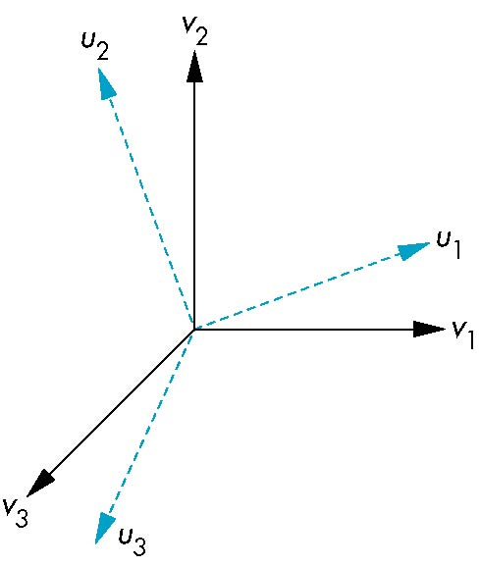
Representing second basis in terms of first
Each of the basis vectors, u₁, u₂, u₃, are vectors that can be represented in terms of the first basis
v
u₁ = γ₁₁v₁ + γ₁₂v₂ + γ₁₃v₃
u₂ = γ₂₁v₁ + γ₂₂v₂ + γ₂₃v₃
u₃ = γ₃₁v₁ + γ₃₂v₂ + γ₃₃v₃

Slide 33
Matrix Form
The coefficients define a 3 x 3 matrix
and the bases can be related by
see text for numerical examples
M =
a = M^{T}b

Slide 34
Change of Frames
We can apply a similar process in homogeneous coordinates to the representations of both points and vectors
Any point or vector can be represented in either frame
We can represent Q₀, u₁, u₂, u₃ in terms of P₀, v₁, v₂, v₃
u₂
u₁
v₂
Consider two frames:
(P₀, v₁, v₂, v₃)
(Q₀, u₁, u₂, u₃)
Q₀
P₀
v₁
u₃
v₃

Slide 35
Representing One Frame in Terms of the Other
Extending what we did with change of bases
u₁ = γ₁₁v₁+γ₁₂v₂+γ₁₃v₃
u₂ = γ₂₁v₁+γ₂₂v₂+γ₂₃v₃
u₃ = γ₃₁v₁+γ₃₂v₂+γ₃₃v₃
Q₀ = γ₄₁v₁+γ₄₂v₂+γ₄₃v₃ +γ₄₄P₀
defining a 4 x 4 matrix
M =

Slide 36
Working with Representations
Within the two frames any point or vector has a representation of the same form
a = [α₁ α₂ α₃ α₄ ] in the first frame
b = [β₁ β₂ β₃ β₄ ] in the second frame
where α₄ = β₄ = 1 for points and α₄ = β₄ = 0 for vectors and
The matrix M is 4 x 4 and specifies an affine transformation in homogeneous coordinates
a = M^{T}b

Slide 37
Affine Transformations
Every linear transformation is equivalent to a change in frames
Every affine transformation preserves lines
However, an affine transformation has only 12 degrees of freedom because 4 of the elements in the matrix are fixed and are a subset of all possible 4 x 4 linear transformations

Slide 38
The World and Camera Frames
When we work with representations, we work with n-tuples or arrays of scalars
Changes in frame are then defined by 4 x 4 matrices
In OpenGL, the base frame that we start with is the world frame
Eventually we represent entities in the camera frame by changing the world representation using the model-view matrix
Initially these frames are the same (M = I)

Slide 39
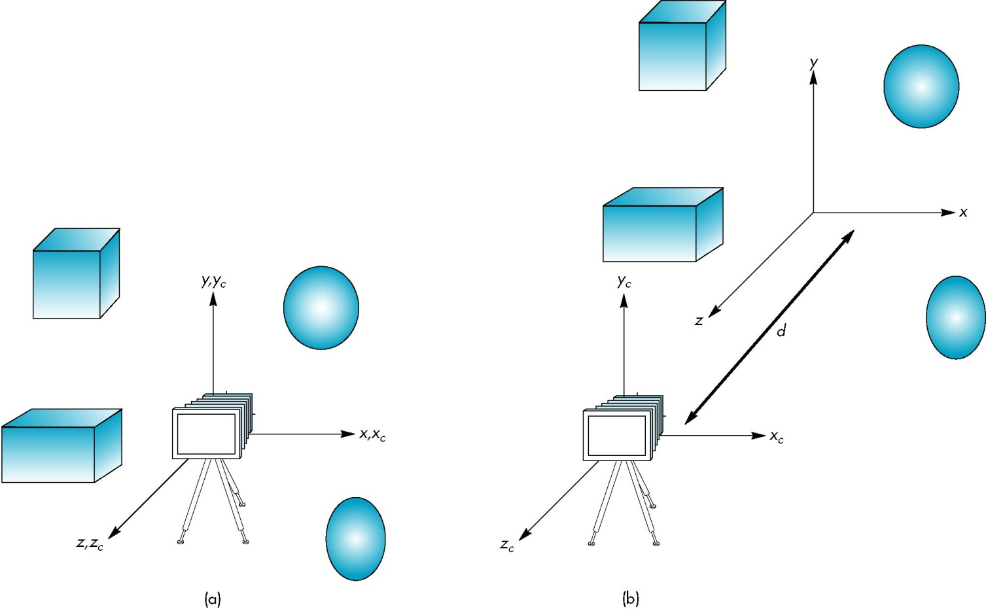
Moving the Camera
If objects are on both sides of z = 0, we must move camera frame
M =

Slide 40
Sesi 2: Transformation

Slide 41
Objectives
Introduce standard transformations
Rotation
Translation
Scaling
Shear
Derive homogeneous coordinate transformation matrices
Learn to build arbitrary transformation matrices from simple transformations

Slide 42
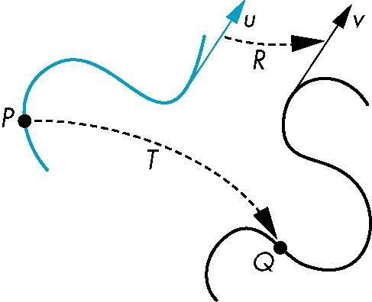
General Transformations
A transformation maps points to other points and/or vectors to other vectors
v=T(u)
Q=T(P)

Slide 43
Affine Transformations
Line preserving
Characteristic of many physically important transformations
Rigid body transformations: rotation, translation
Scaling, shear
Importance in graphics is that we need only transform endpoints of line segments and let implementation draw line segment between the transformed endpoints

Slide 44
Pipeline Implementation
v
T
(from application program)
frame
buffer
u
transformation
T(u)
rasterizer
T(v)
T(v)
T(v)
v
T(u)
u
T(u)
vertices
vertices
pixels

Slide 45
Notation
We will be working with both coordinate-free representations of transformations and representations within a particular frame
P, Q, R: points in an affine space
u, v, w: vectors in an affine space
α, β, γ: scalars
p, q, r: representations of points
-array of 4 scalars in homogeneous coordinates
u, v, w: representations of points
-array of 4 scalars in homogeneous coordinates

Slide 46
Translation
Move (translate, displace) a point to a new location
Displacement determined by a vector d
Three degrees of freedom
P’=P+d
P’
d
P

Slide 47
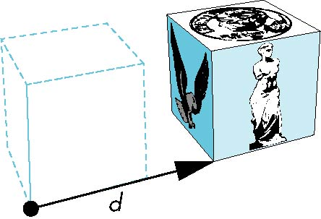

How many ways?
Although we can move a point to a new location in infinite ways, when we move many points there is usually only one way
object
translation: every point displaced
by same vector

Slide 48
Translation Using Representations
Using the homogeneous coordinate representation in some frame
p = [ x y z 1]^{T}
p’ = [x’ y’ z’ 1]^{T}
d = [dx dy dz 0]^{T}
Hence p’ = p + d or
x’ = x + d_{x}
y’ = y + d_{y}
z’ = z + d_{z}
note that this expression is in
four dimensions and expresses
point = vector + point

Slide 49
Translation Matrix
We can also express translation using a
4 x 4 matrix T in homogeneous coordinates
p’=Tp where
T = T(d_{x}, d_{y}, d_{z}) =
This form is better for implementation because all affine transformations can be expressed this way and multiple transformations can be concatenated together

Slide 50
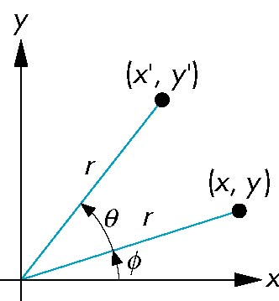
Rotation (2D)
Consider rotation about the origin by θ degrees
radius stays the same, angle increases by θ
x ‘= r cos (φ + θ)
y ‘= r sin (φ + θ)
x’ = x cos θ – y sin θ
y’ = x sin θ + y cos θ
x = r cos φ
y = r sin φ

Slide 51
Rotation about the z axis
Rotation about z axis in three dimensions leaves all points with the same z
Equivalent to rotation in two dimensions in planes of constant z
or in homogeneous coordinates
p’=R_{z}(θ)p
x’ = x cos θ –y sin θ
y’ = x sin θ + y cos θ
z’ = z

Slide 52
Rotation Matrix
R = R_{z}(θ) =

Slide 53
Rotation about x and y axes
Same argument as for rotation about z axis
For rotation about x axis, x is unchanged
For rotation about y axis, y is unchanged
R = R_{x}(θ) =
R = R_{y}(θ) =

Slide 54
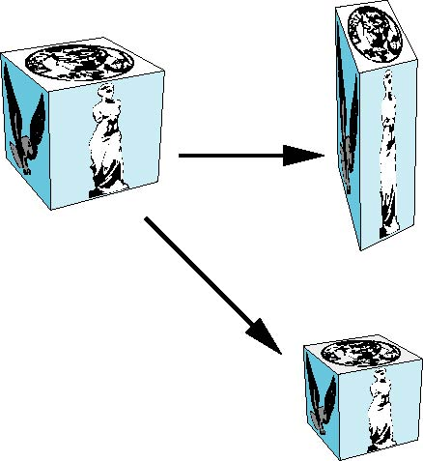
Scaling
Expand or contract along each axis (fixed point of origin)
x’ = s_{x}x
y’ = s_{y}x
z’ = s_{z}x
p’ = Sp
S = S(s_{x}, s_{y}, s_{z}) =

Slide 55
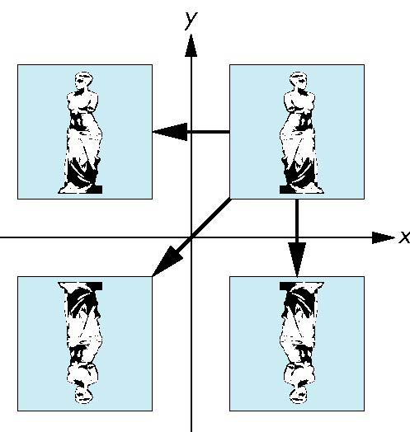
Reflection
corresponds to negative scale factors
s_{x} = -1 s_{y} = 1
original
s_{x} = -1 s_{y} = -1
s_{x} = 1 s_{y} = -1

Slide 56
Inverses
Although we could compute inverse matrices by general formulas, we can use simple geometric observations
Translation: T⁻¹(d_{x}, d_{y}, d_{z}) = T(-d_{x}, -d_{y}, -d_{z})
Rotation: R ⁻¹(θ) = R(-θ)
Holds for any rotation matrix
Note that since cos(-θ) = cos(θ) and sin(-θ)=-sin(θ)
R ⁻¹(θ) = R ^{T}(θ)
Scaling: S⁻¹(s_{x}, s_{y}, s_{z}) = S(1/s_{x}, 1/s_{y}, 1/s_{z})

Slide 57
Concatenation
We can form arbitrary affine transformation matrices by multiplying together rotation, translation, and scaling matrices
Because the same transformation is applied to many vertices, the cost of forming a matrix M = ABCD is not significant compared to the cost of computing Mp for many vertices p
The difficult part is how to form a desired transformation from the specifications in the application

Slide 58
Order of Transformations
Note that matrix on the right is the first applied
Mathematically, the following are equivalent
p’ = ABCp = A(B(Cp))
Note many references use column matrices to represent points. In terms of column matrices
p^{’T} = p^{T}C^{T}B^{T}A^{T}

Slide 59
General Rotation About the Origin
A rotation by θ about an arbitrary axis
can be decomposed into the concatenation
of rotations about the x, y, and z axes
θ
R(θ) = R_{z}(θ_{z}) R_{y}(θ_{y}) R_{x}(θ_{x})
y
v
θ_{x} θ_{y} θ_{z} are called the Euler angles
Note that rotations do not commute
We can use rotations in another order but
with different angles
x
z

Slide 60
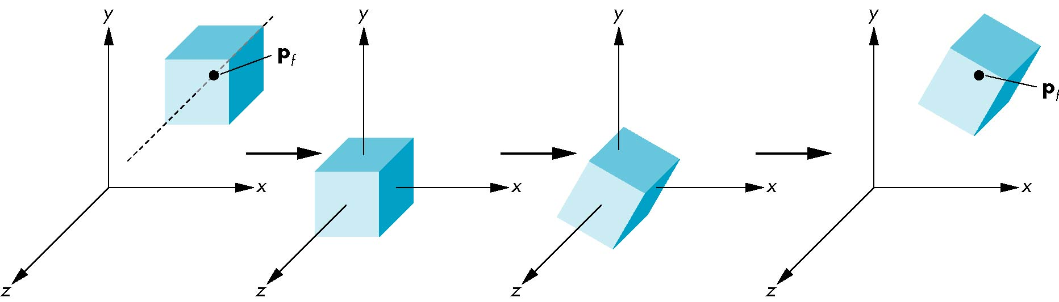
Rotation About a Fixed Point other than the Origin
Move fixed point to origin
Rotate
Move fixed point back
M = T(p_{f}) R(θ) T(-p_{f})

Slide 61
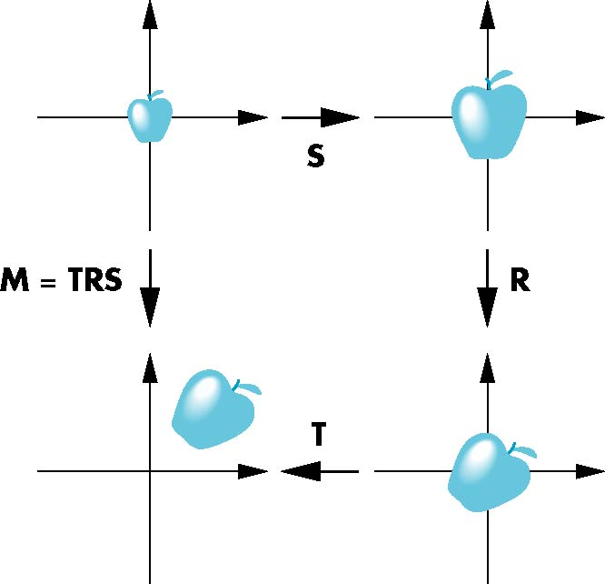
Instancing
In modeling, we often start with a simple object centered at the origin, oriented with the axis, and at a standard size
We apply an instance transformation to its vertices to
Scale
Orient
Locate

Slide 62
Lab Works
Programming di Kelas

Slide 63
Task 6: Rotated Sierpinski Gasket
Create a rotated Sierpinski Gasket by combining rotation code of Task 5 and code of Sierpinski Gasket (example 1.cpp) so that the points are rotated.
Experiment with the number of points
What is the limit of number of points that results in smooth rotation?

Slide 64
Task 7: Scaling
Modify Task 6 by following these steps:
Ubah supaya penghitungan sin(angle) dan cos(angle) dilakukan di program C++ dan hasilnya dikirim ke vertex shader sebagai variabel uniform float: sinAngle dan cosAngle
Hasilnya akan sama dengan Task 6, tetapi kode lebih efisien karena penghitungan sin dan cos dilakukan sekali untuk semua verteks, tidak berkali-kali (sejumlah verteks)
Kalikan nilai sin dengan 0.5 dan kalikan nilai cos dengan 2. Apa yang terjadi?
Eksperimen dengan pengali yang berbeda-beda untuk nilai sin dan cos
Apa yang terjadi jika nilai sin dikalikan 2 dan nilai cos tetap?

Slide 65
Task 8: General Transformations (1)
Modify Task 7 by following these steps:
Buat sebuah variabel global multipliers
GLuint multipliers;
Set variabel global tsb menggunakan glGetUniformLocation pada fungsi init
multipliers = glGetUniformLocation(program, "multipliers");
Pada fungsi display, buatlah sebuah matriks 2x2 sbg berikut:
mat2 multipliers_mat = mat2( vec2(cos(angle), -sin(angle)),
vec2(sin(angle), cos(angle)));
glUniformMatrix2fv( multipliers, 1, GL_TRUE, multipliers_mat );

Slide 66
Task 8: General Transformations (2)
Pada vertex shader
ganti variabel sinAngle dan cosAngle dengan variabel uniform mat2 multipliers
ubah penggunaan sinAngle dan cosAngle dengan multipliers
gl_Position.xy = multipliers * vPosition.xy;
Verifikasi program ini dengan mengecek apakah sudah menghasilkan hasil yang sama dengan Task 7

Slide 67
Task 9: Rotating in other dimensions
Modify Task 8 by following these steps:
Modifikasi code sehingga rotasinya bukan lagi merotasi koordinat x dan y, melainkan koordinat y dan z yang dirotasi
Lakukan hal yang sama untuk merotasi koordinat x dan z
Ubah matriks 2x2 menjadi matriks 3x3
mat3 mTransform = mat3(1.0, 0.0, 0.0,
0.0, cos(angle), -sin(angle),
0.0, sin(angle), cos(angle) );
glUniformMatrix3fv( transform, 1, false, mTransform );

Slide 68
Next Week: Programming di Kelas

